Slide 1
Raymond James 37th Annual Institutional Investors Conference

Slide 2
Forward Looking Statements
Statements in this presentation that relate to forecasts, estimates or other expectations regarding future events and any other statements which provide other than historical information, including, without limitation, statements regarding technological advancements and our financial position, business strategy and plans and objectives of management for future operations, may be deemed to be forward-looking statements within the meaning of Section 27A of the Securities Act of 1933 and Section 21E of the Securities Exchange Act of 1934. Such forward looking statements are based on the beliefs of management as well as assumptions made by and information currently available to management. Actual results could differ materially from those contemplated by the forward looking statements as a result of certain factors. These risks include, but are not limited to, dependence upon energy industry spending; the volatility of oil and natural gas prices; high fixed costs of operations and high capital requirements; operational disruptions; changes in economic conditions; industry competition; reduced utilization; the potential for contract delays, reductions or cancellations of service contracts; external factors affecting the Company’s crews such as weather interruptions and inability to obtain land access rights of way; disruptions in the global economy; whether the Company enters into turnkey or dayrate contracts; crew productivity; the availability of capital resources; limited number of customers; and credit risk related to our customers. A discussion of these and other factors, including risks and uncertainties, is set forth in the Company’s Form 10-Q that was filed with the Securities and Exchange Commission on November 6, 2015 and in Exhibit 99.5 to the Company’s Form 8-K/A that was filed with the Securities and Exchange Commission on April 30, 2015. Dawson Geophysical Company disclaims any intention or obligation to revise any forward-looking statements, whether as a result of new information, future events or otherwise.

Slide 3
What We Do
Acquire and process seismic surveys for our clients
Our clients include Major, Mid-Tier, Independent Oil and Gas Companies and Multi-Client Data Library Providers
Seismic data are utilized to map subsurface geology, similar to 3D sonograms in the medical field
Full service provider with the ability to facilitate projects from conception to completion
Business model is focused to help Exploration and Production Companies find and develop oil and gas reservoirs
Our services can reduce dry-hole risk and reduce finding and development costs
Help to maximize the full array of science available resulting in more informed drilling decisions to further de-risk exploration and production economics

Slide 4
Adding Value to the Oil and Gas Industry
Seismic data add value throughout the exploration and production process
Seismic data are used in the Exploration, Evaluation and Exploitation of hydrocarbons
High resolution data helps to identify subsurface structures that have potential accumulations of hydrocarbons in conventional reservoirs, identifies geo-hazards, and provides horizontal drilling guidance in unconventional reservoirs
Seismic data further supports the goals of maximizing exploration and production economics

Slide 5
Dawson’s Driving Factors
Clients
Six decades of meeting and exceeding client’s exploration goals
Focused on relationships and trust
Reputation built on ‘Doing it Right’
People
The Company’s most important asset
The deepest and most experienced talent in the industry
Focused on mentoring and cross-training for long-term strength
Shareholders
Confidence built on delivering returns through judicious management of assets
Accountable and ‘As Good As Our Word’
Historical balance sheet strength helps navigate the cyclical nature of the industry

Slide 6
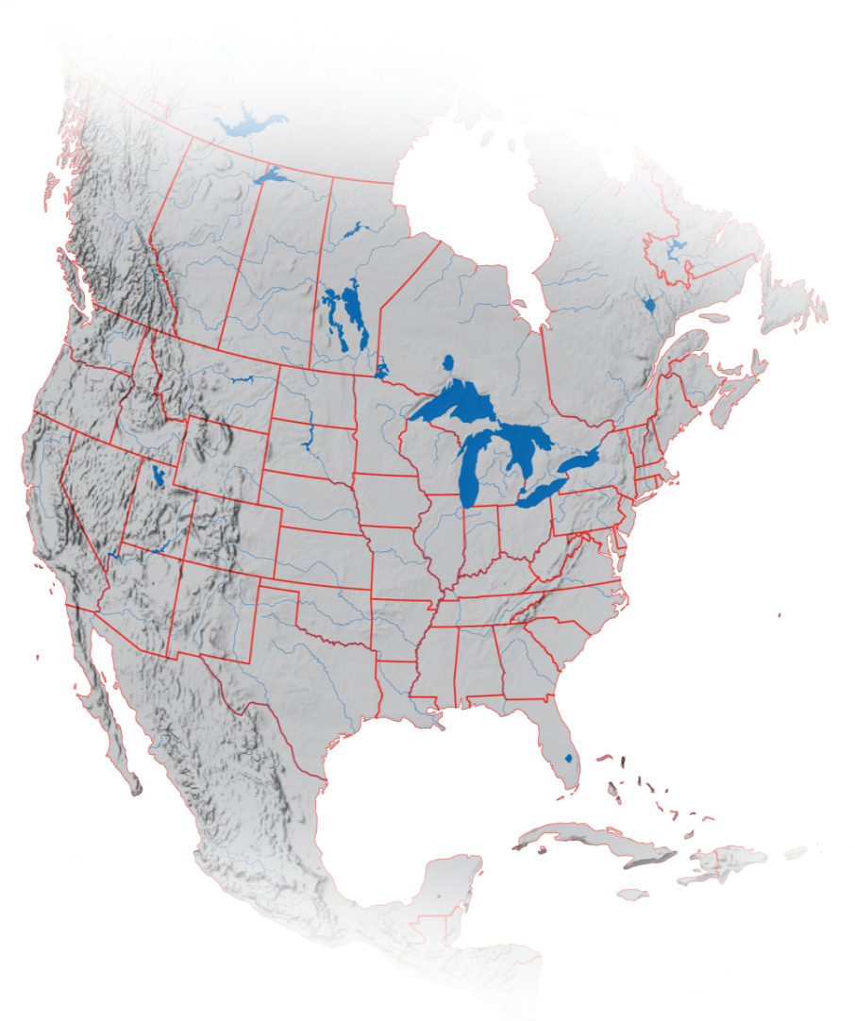
About Dawson Geophysical
A leading provider of U.S. onshore and Canadian seismic data acquisition services (2-D, 3-D and Multi-Component)
Providing high quality imaging for 63 years
Superior equipment base and improved logistics increase utilization and lower costs
Industry leading internal support services that reduces outsourcing
Trusted client base built on experience, relationships and performance
Calgary
Denver
Oklahoma City
Oklahoma City
Midland
Plano
Houston

Slide 7
Investment Highlights
Strong balance sheet
Conservative approach to efficiently maneuver changing market conditions
Capability to respond to evolving industry standards
Provides flexibility to be first adapters of new technology to meet increased client demands
Substantial equipment base
Increases efficiencies and operational coordination during favorable market conditions
Ability to use the most efficient technology for specific areas
Allows for competitive advantage and increased flexibility to meet client goals
Expansive geographic knowledge
Experience across every basin in the Lower 48 and Canada
Knowledge to efficiently adapt in all working environments and conditions
Broad client base built on trust
Recognized leader in the industry sector
Six decades of meeting and exceeding clients’ exploration needs

Slide 8
Geophysical Expertise: Essential In All Phases of the Cycle
Present downturn requires Exploration and Production Operators to maximize production at reduced finding costs
Current commodity pricing requires companies to focus on improved project economics which seismic data facilitates
Demand for high-resolution images continues during market pullback
Increased channel count efficiencies for enhanced subsurface resolution imaging provided by DWSN’s strength of assets
Advancements in technology
Increased utilization of state-of-the-art cable-less recording equipment

Slide 9
Success in Previous Downturns
1980 Downturn
Emerged from the 1980’s downturn as an early provider in 3D seismic surveys
DWSN increased market penetration and grew during the market upswing
Significant capital expenditures to acquire digital recording equipment
Late 1990’s Pullback
Emerged from 1990’s pullback with experienced personnel and equipment base
Positioned DWSN to successfully participate in the unconventional natural gas cycle
Large capital expenditures to acquire cable equipment platform and channel count increase

Slide 10
Success in Previous Downturns
Great Recession of 2008-2009
Emerged from 2009 financial crisis with balance sheet strength
Enabled DWSN to emerge as a financially strong company, acquire seismic equipment at reduced prices and participate in the market upswing
Substantial capital expenditures to acquire cable-less equipment
2014-2015 Oil Crash
Improved platform of services, equipment, and people combined with a stronger balance sheet following the merger with TGC Industries
Maintained focus on the balance sheet with an improved platform of services, equipment and people which positions DWSN to participate in improving market conditions
State-of-the-art equipment base in place to capture improvement in market conditions

Slide 11
Maintaining Our Commitment
Continue in our role as the industry leading full-service provider of data acquisition and data processing services
Preserve a first-class Health, Safety, Security and Environmental Program
Ongoing commitment to superior land survey and permitting services, expanded repair capabilities, trucking services, data processing, technical advancements and dynamite energy source drilling services
Sustained top rated platform of shared resources -- people, equipment and services -- that benefit our clients, shareholders and employees

Slide 12
OPERATIONS OVERVIEW

Slide 13
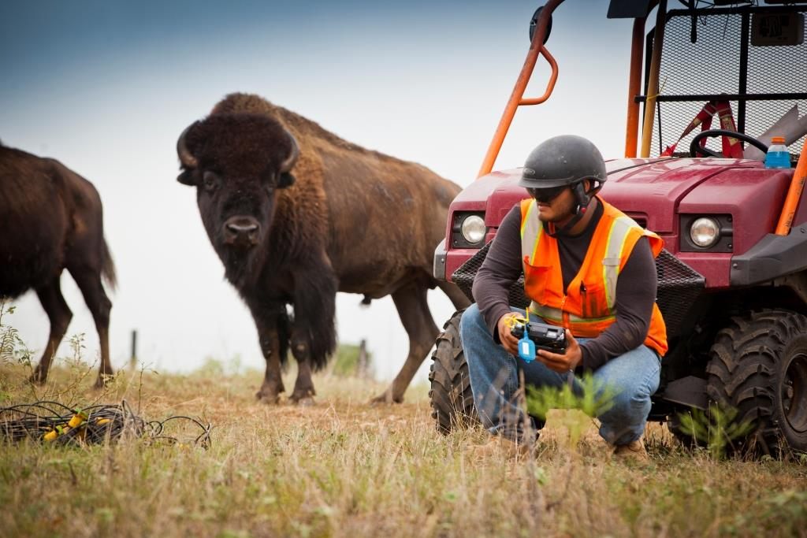
Primary Business Drivers
Data Acquisition
Design
Permit
Survey
Field Operations
Maintenance
Support Functions
Dynamite Energy Services
Microseismic Monitoring
Data Processing
Facilities in Midland, Oklahoma City, Houston
In-field Services

Slide 14
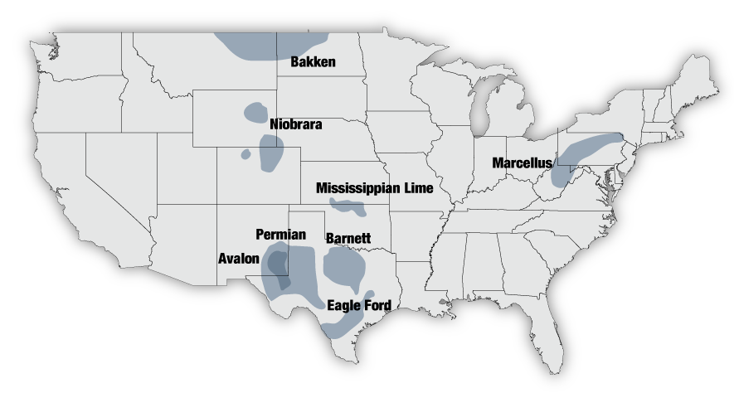
Areas of Operation
Activity currently focused in the Permian Basin, Delaware Basin, Southeast US and the Oklahoma SCOOP Stack

Slide 15
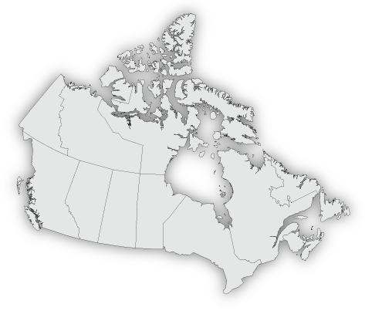
Canadian Strength
Eagle Canada is a wholly owned subsidiary of DWSN
Industry leader in the Canadian market
Leveraging Eagle Canada’s existing relationships and strong brand name recognition
Streamlined operations increases efficiencies and lowers costs
Calgary
Canada

Slide 16
Robust Inventory Drives Results
14 Crew Capacity
4 ARAM ARIES Systems
8 GSR Systems
24,000 INOVA Hawk Channel System
170,000 channels of GSR multi-channel boxes with 3-C geophones
Recording Channels
275,000
Vibrator Energy Source Units
209 energy source units
8 Envirovib units
Data Processing Services
Houston
Oklahoma City
Midland

Slide 17
2016 Overview
Demand for DWSN services anticipated to be at reduced levels
Balance sheet strength remains strong with approximately $72,602,000 of working capital and approximately $12,183,000 of debt as of September 30, 2015
2016 Capex anticipated to be at maintenance levels of less than $10,000,000
Expanded channel count shortens cycle times and provides higher resolution images
Continued use of Multi-Component equipment

Slide 18
Capital Structure
History of conservative financial management in a cyclical industry
Low debt – comprised of short term notes payable for equipment purchases and insurance as well as capital lease obligations
Well-positioned to respond to future client demand
Balance Sheet Data ($ in thousands)
Sept. 30, 2015
Working Capital | $72,602
Net Property, Plant and Equipment | $154,146
Total Assets | $260,291
Debt | $12,183
Stockholders’ Equity | $214,796

Slide 19
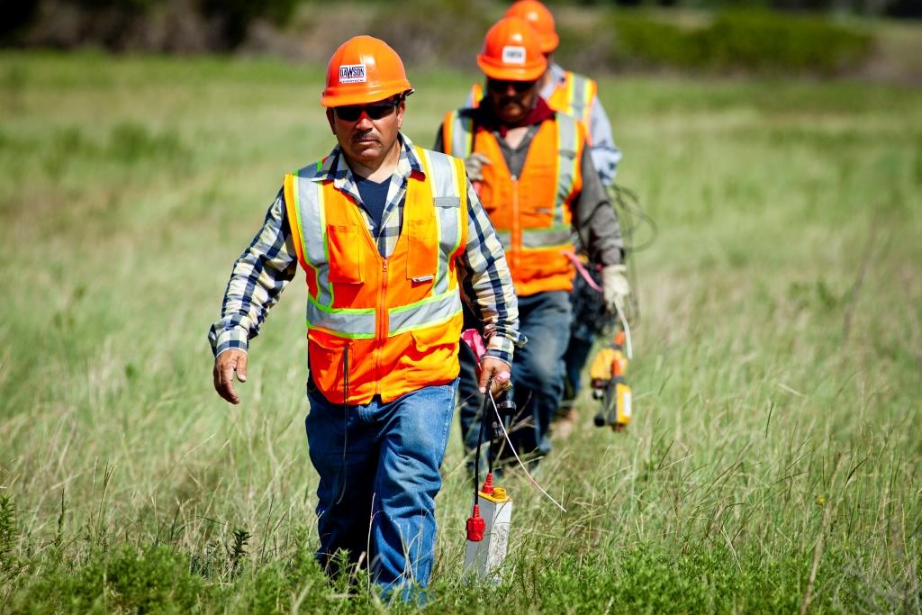
Corporate Profile
Current Stock Price: $3.80
(March 1, 2016)
Market Cap: $81.97 Million
Average Daily Volume: 53,074 shares
Shares Outstanding: 21.57 Million
Pre-transaction Fiscal Year-end September 30; Post-transaction Fiscal Year-end December 31

Slide 20
NASDAQ: DWSN

